Slide 1
Bed Occupancy Alarm System
Helping you get out of bed since 2020 (kicked you in the ass and left you on the curb wearing pajamas)
Dana Deutsch

Slide 2
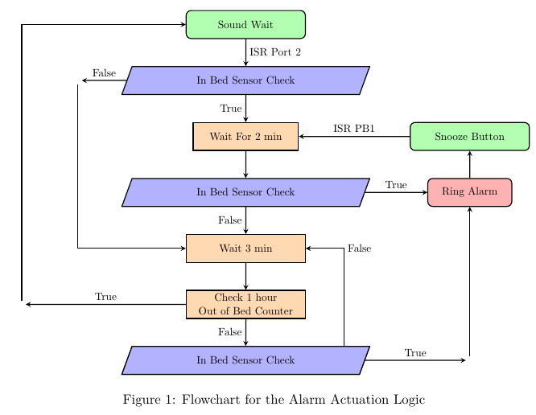
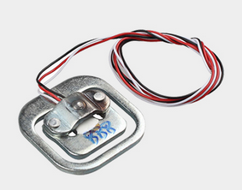
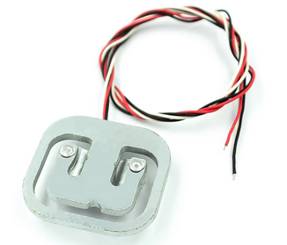
If you fall back to sleep after turning off your alarm, or don’t have the motivation to leave the bed, this product is for you
Senses when your phone alarm goes off
Keeps ringing intermittently (must keep pressing snooze) until you leave the bed
Will not allow to return to bed without it continuing to ring to allow you to fully wake up

Slide 3
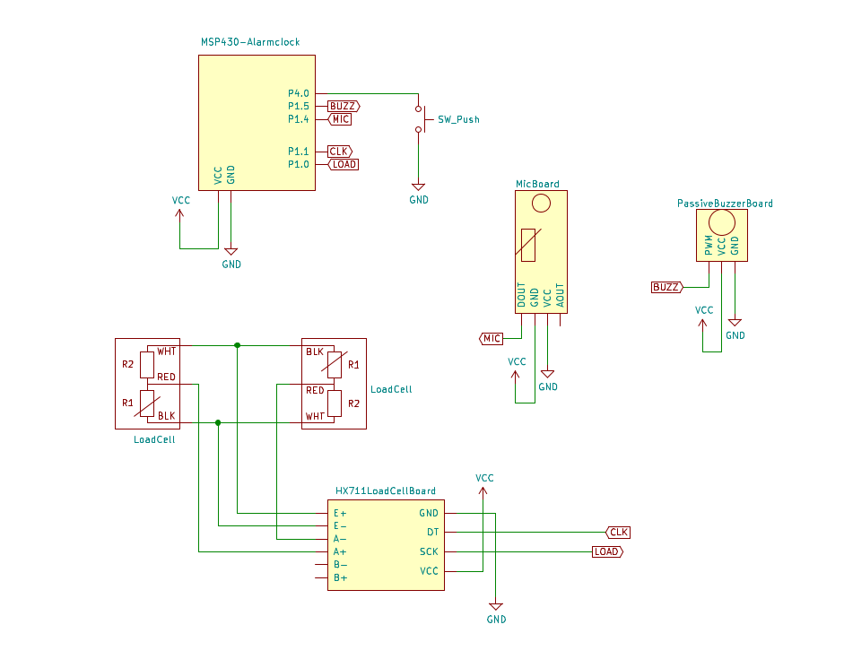
System Components
MSP430
Half Bridge Load Sensors
Amplifier and ADC for Wheatstone Bridge circuit strain gauge signal conditioning
Push Button
Piezo Buzzer
Microphone Sensor
Optional: C# form

Slide 4
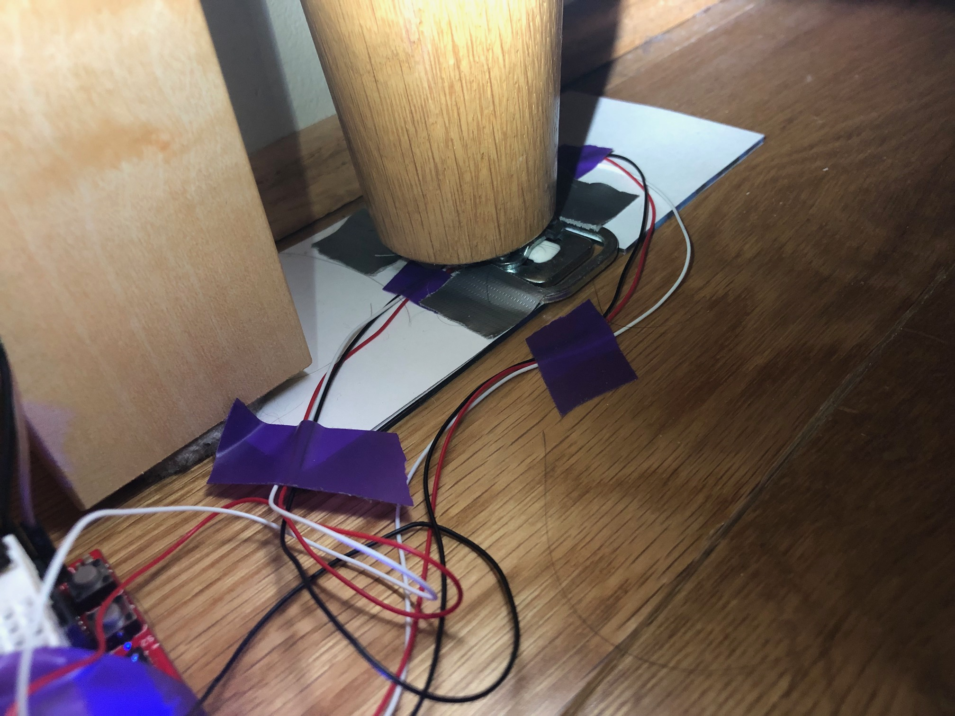
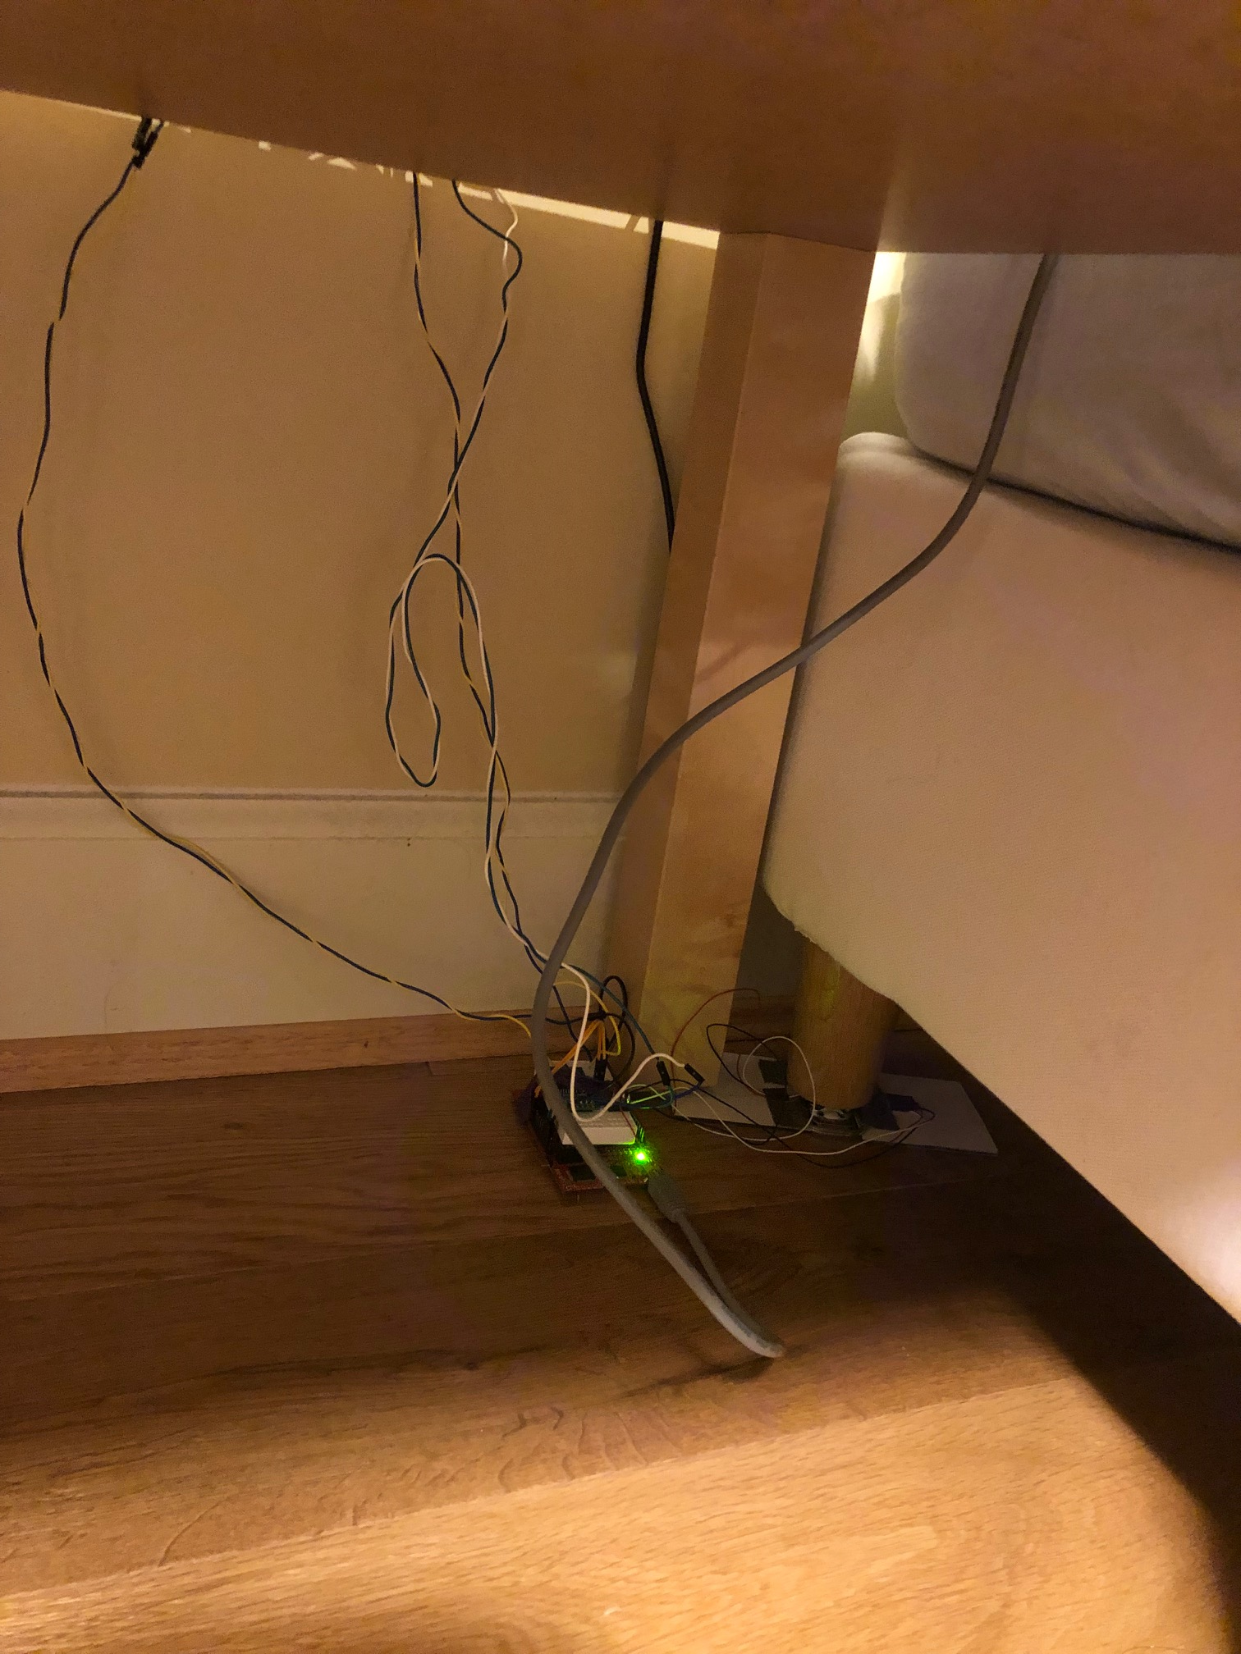
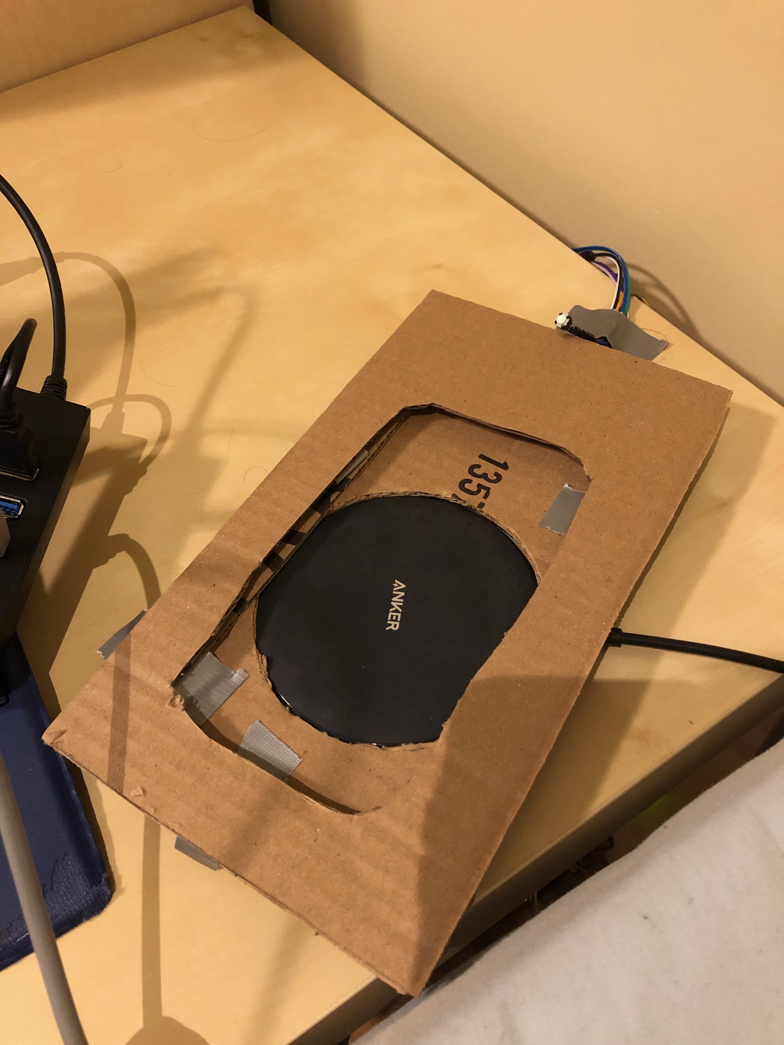
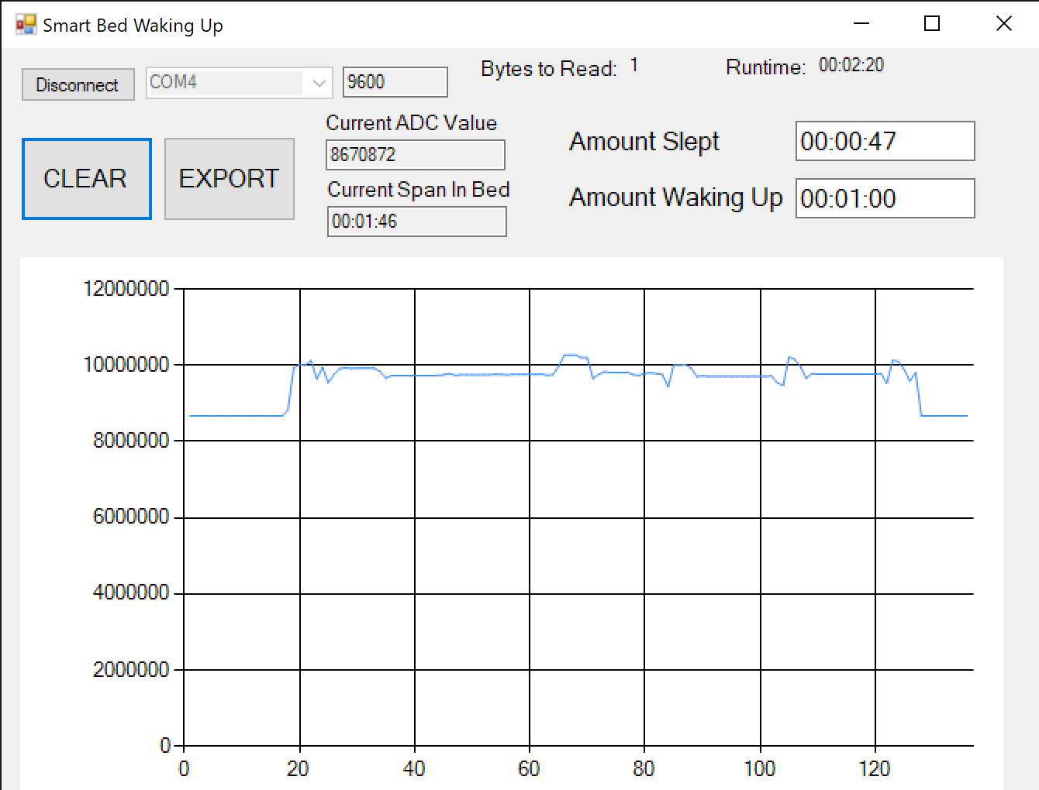
Real System
Push Button
Buzzer and Mic Under here

Slide 5
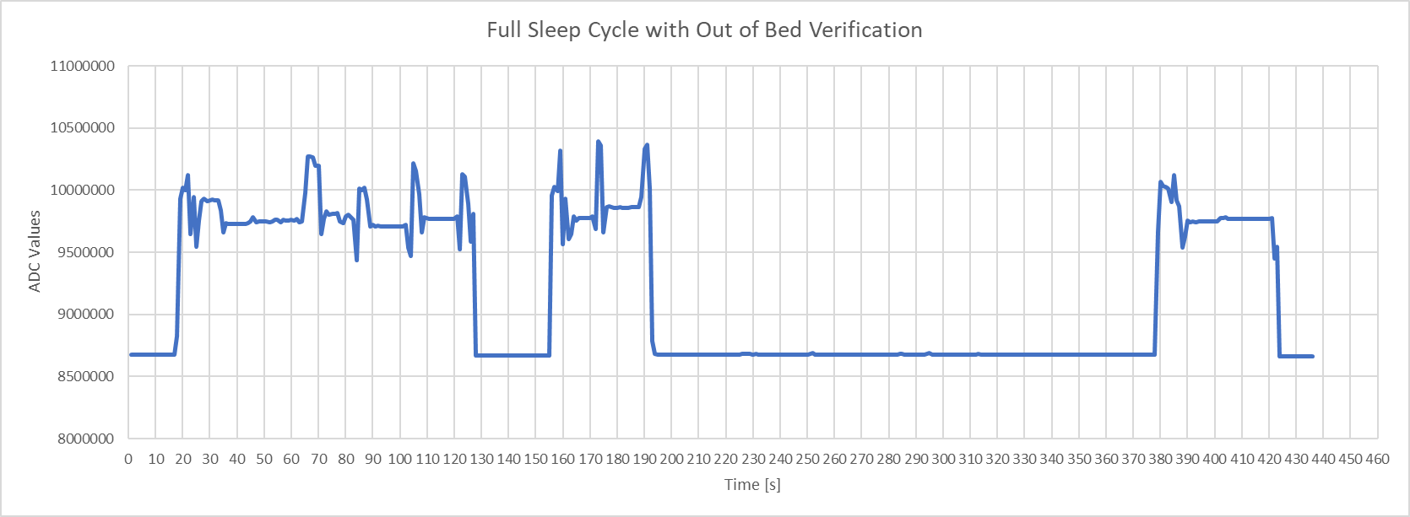
Example Cycle
We see spikes because I lean on the corner/edge of the bed where the sensor is located when reaching to turn off the alarms
Enter Bed
Phone Alarm
47
Enter bed and go to sleep – Woken Up by phone alarm – Turn off but stay in Bed

Slide 6
Example Cycle
We see spikes because I lean on the corner/edge of the bed where the sensor is located when reaching to turn off the alarms
Buzzers
Buzzers
Buzzers
Exit Bed
10
10
10
56
Snooze rings every 10 seconds after turning off the phone alarm until we leave the bed

Slide 7
Example Cycle
We see spikes because I lean on the corner/edge of the bed where the sensor is located when reaching to turn off the alarms
Buzzers
In bed with no Buzzer
10
10
35
44
29
188
Returning under 2 min will keep ringing the snooze – After 2min system cycle ends bed can be entered

